Slide 1
WHEN CHILDREN PARTICIPATE
Increasing as citizens of today while looking towards tomorrow

Slide 2
Legge provinciale n.13/77
Provincia autonoma di Trento (Trient)
Kindergartens
Equivalent kindergartens
Managed by entities, institutions, or private organizations, existing and operational as of the date of entry into force of the Law
Managed by the Province and the Municipalities

Slide 3
Circolo di Ala
Circolo Alta Valsugana
Circolo di Borgo Valsugana
Circolo Giudicarie Esteriori
Circolo di Mezzocorona e Val di Cembra
Circolo di Mezzolombardo
Circolo di Mori
Circolo di Riva del Garda
Circolo di Rovereto e Vallagarina
Circolo di Sarche
Circolo di Trento 1
Circolo di Trento 2
Circolo di Trento 3
Circolo Val di Fiemme e Val di Cembra
Circolo Val di Fiemme e Val di Fassa
Circolo Val di Non
Circolo Val di Non e Val di Sole
Circolo Valle del Chiese
Circolo Val Rendena
Circolo Valsugana e Primiero
20 cycles of coordination

Slide 4
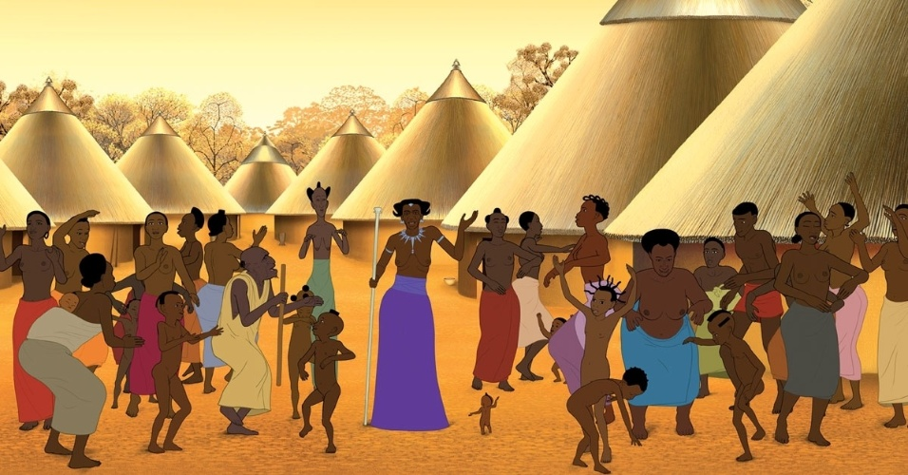
Education concerns « the entire village»
On the life and future of children, there are relevant issues open for everyone
THE CHOICES OF THE FEDERATION
Focus on thinking and planning
Opening up to inter-action to generate social value

Slide 5
THE KINDERTGARTEN’S THINKING
Focus on thinking, relationship and community
Must be realized through the school project
Learning experiences

Slide 6
SUPPORT CHILDREN'S THINKING
To foster responsibility and belonging towards one's own community and the institutions operating within it, such as the schoolper
To support the pleasure and interest in participating in public life, while paying attention to the common good and sharing desires and projects with othersper

Slide 7
The theoretical framework in schools associated with the Federation is:
SOCIO-CONSTRUCTIVIST THEORY
Authors: Bruner, Gardner, Pontecorvo, Zucchermaglio
Socio" is used because learning is not solely individual but occurs within social interactions and the surrounding environment.
"Constructivist" is used because it emphasizes the active role of children in constructing their own learning. In this perspective, children are not passive recipients of knowledge but actively build their own understanding and skills through experiences and interactions with the surrounding world.

Slide 8
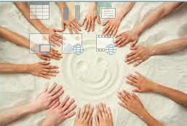
It results in an idea of the children…
Competent
Multiple
Social
Children learning by doing and participating..
Learning by participating
The centrality of designing meaningful, motivating, and enriching experiences"

Slide 9
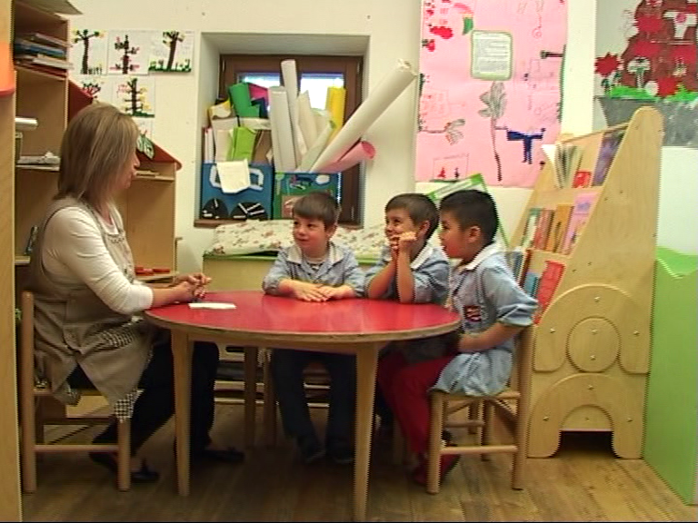
RULE OF EDUCATOR IN THE SOCIAL INTERACTION
Observing
Listening
Understanding
Building rich and stimulating learning contexts
Supporting the participation of everyone
Promoting the circulation of ideas
Supporting reasoning and task completion towards the most productive directions
Valuing potential disagreement

Slide 10
Participation and responsibility
One participates when learning from others and when teaching others
One participates when situations are interesting, rich, and challenging (not simplified, depowered)
Complexity activates participation, it does not inhibit it.

Slide 11
The idea: deciding together is possible
…rarely the children
are involved in decision-making processes regarding aspects that directly concern them
So let's give the floor to children to discuss and make decisions as a group, to give citizenship to their thoughts and their design capacity

Slide 12
1. AUTHENTICITY
«Teacher, but then do we really do it?»
It is an essential condition to give the pleasure of thinking a real path, a becoming action that changes life contexts and allows experiencing the effective impact on reality of one's reflective and projective action
In the experience of involvement and active participation, it is crucial that concrete implementation follows what has emerged from the discussion with the children
REAL REDESIGN SPACES
REAL ISSUE
FEASABLE

Slide 13
2. AGREEING AS A GROUP
It's the group that decides together. While creating the best conditions for each child to express themselves personally and to grow in skills, the focus has been brought by the teachers to building a project shared by the group.
Experimenting with forms of democratic participation, nourishing one's own thinking with that of others, building knowledge and relationships together with others for a future to inhabit with the belief that 'deciding together is possible’

Slide 14
BEACOUSE IN SMALL GROUPS
It facilitates discussion and allows everyone to participate.
There are more direct exchanges between children.
It's easier to remember classmates' contributions
this methodology allows for experimenting with forms of CIVIC LABORATORY in which to help children express their own opinions, listen, engage with different ideas, refine their critical thinking skills, negotiate, enriching their own thinking with that of others
It is necessary to build 'familiarity' with the method, with the type of involvement required, with classmates, in order to open up and trust more and more
GIVING AND TAKING TIME

Slide 15
Corsaro, W. (2003). Le culture dei bambini. Bologna: Il Mulino.
Pontecorvo, C., Ajello, A.M., Zucchermaglio, C. (1991). Discutendo si impara. Roma: Carocci.
Silvia Cavalloro, Decidere insieme si può. AltriSpazi n. 1, pp. 9-12 www.fpsm.tn.it
Camilla Monaco, Maestra, ma poi lo facciamo davvero? AltriSpazi n. 2 pp. 9-12 www.fpsm.tn.it
Camilla Monaco, Ci vuole anche la montagna, perché Susà è un paese di montagna. AltriSpazi n. 6 pp. 5-13 www.fpsm.tn.it

